Slide 1
Introduction
History:
The sakila database was initially developed by mike hillyer, a former member of the mysql ab documentation team, and is intended to provide a standard schema that can be used for examples in books, tutorials, articles, samples, and so forth.
The first official version of the sakila sample database was released in march 2006.
About sakila database:
The sakila database is a nicely normalised schema modelling a dvd rental store, featuring things like films, actors, film-actor relationships, and a central inventory table that connects films, stores, and rentals.

Slide 2
Data set & Data Dictionary
Variable Name Description
Rental Unique id is rental_id where having all rental details
Film Unique id is film_id where having all film details
Staff Unique id is staff_id where having all staff details
Address Unique id is address_id where having all address details
about staff and Customers
Customer Unique id is customer_id where having all details of customers
Payment Unique id is payment_id where all details of payments
Film category Unique id is category_id where film category names available
Actor Unique id is actor_id all actor id and actor names available
Language Unique id is language_id where details of movie language available
City Unique id is city_id where all city names of customers and staff
Country Unique id is country_id where all country names of customers and staff
Inventory Unique id is inventory_id details of staff id available
Film actor Unique id is film_id and actor_id where details of film and actor are available

Slide 3
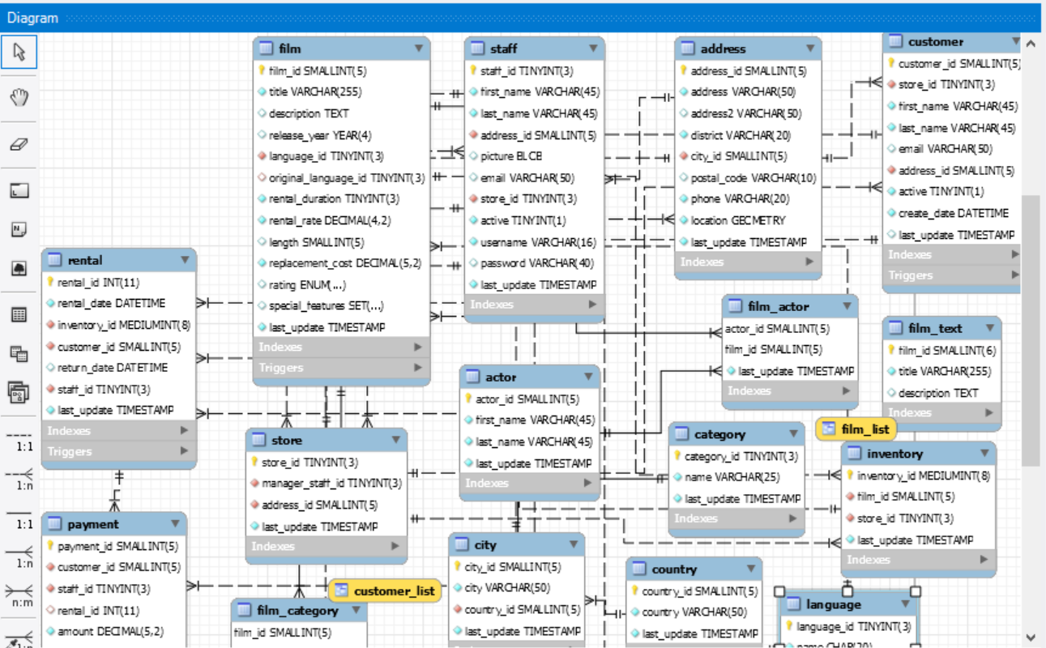
Entity Relationship Diagram

Slide 4
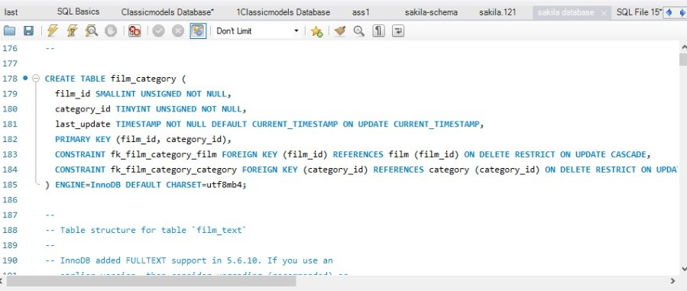
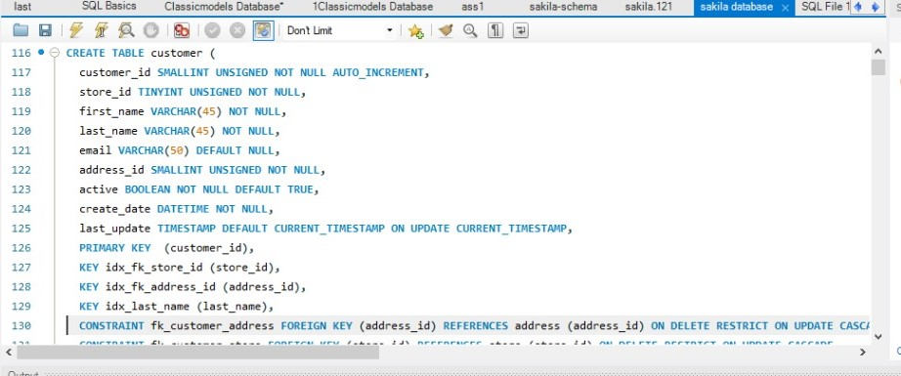
Building Table

Slide 5
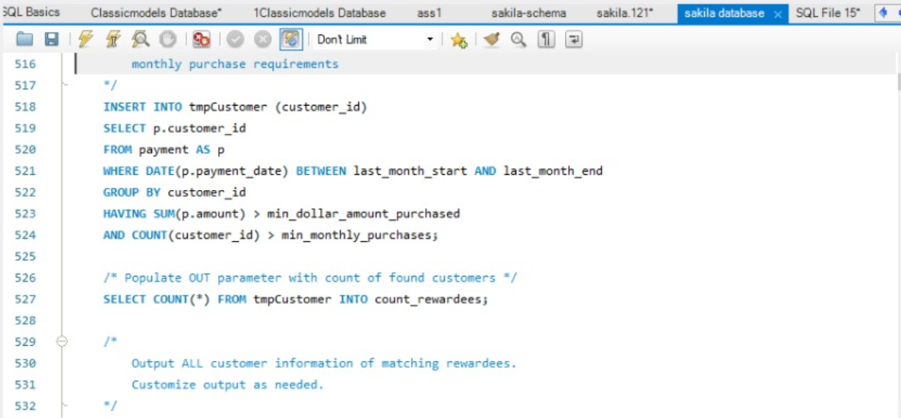
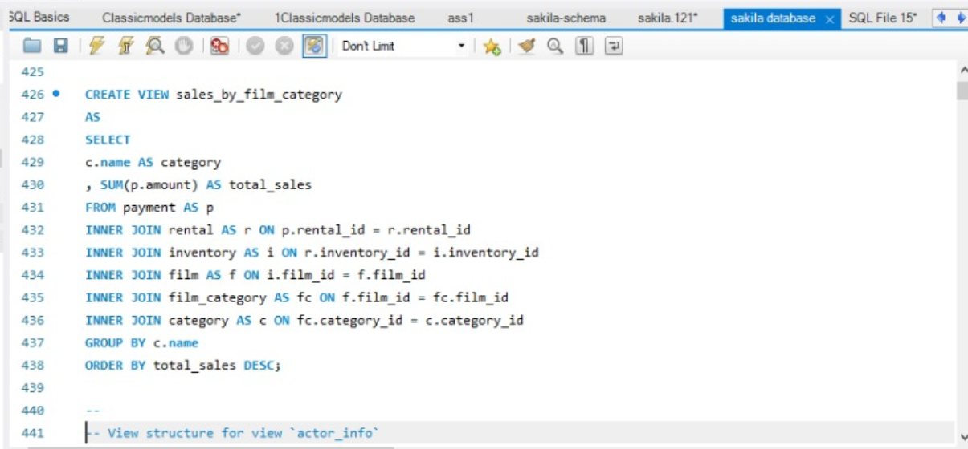
Uploading Data

Slide 6
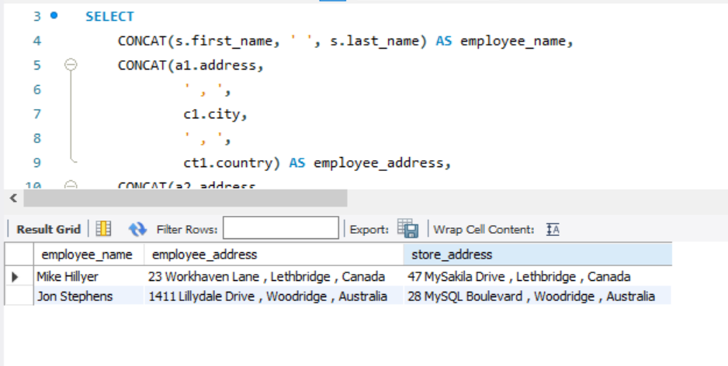
Query1: #List all employees names, employee address and store address.

Slide 7
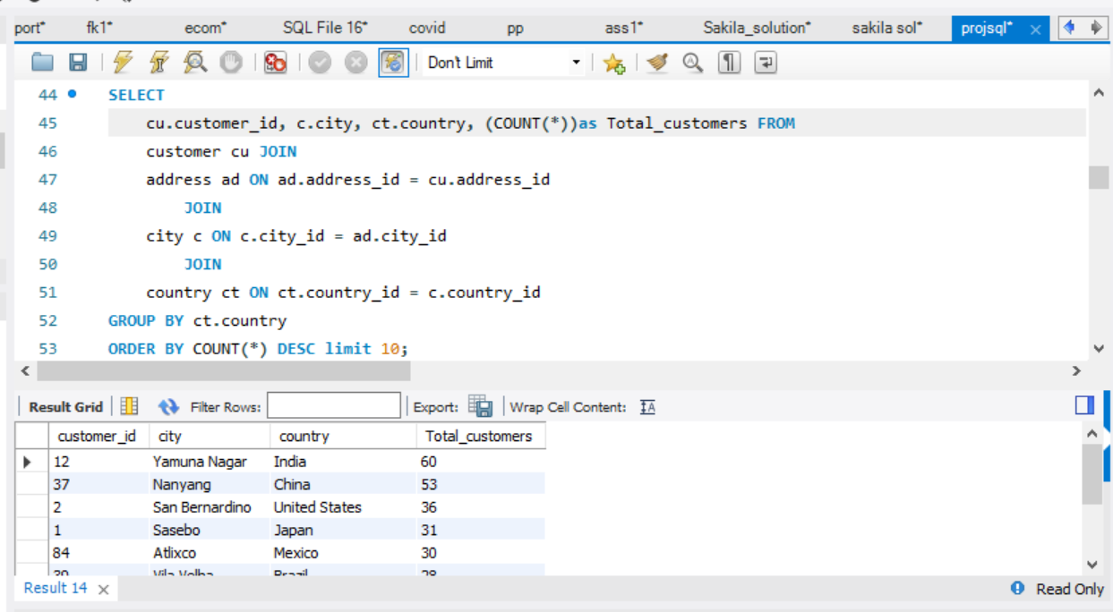
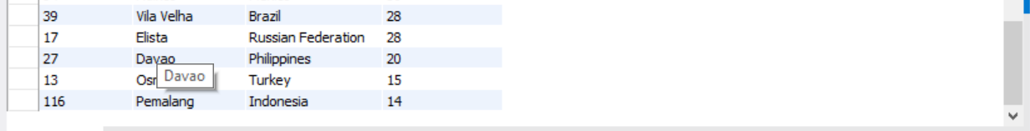
Query2:Number of customers from each country

Slide 8
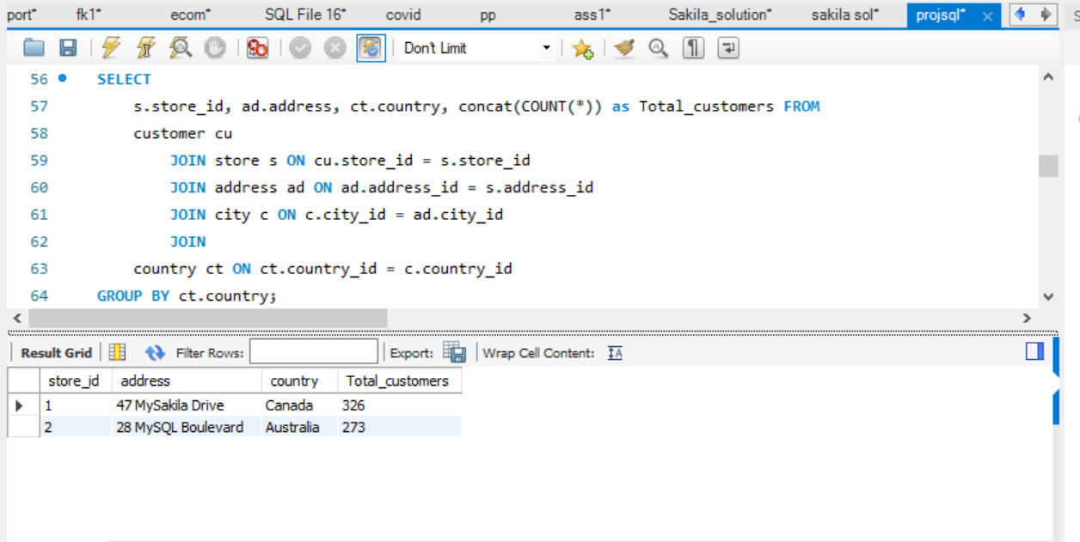
Query3: Number of customers for each store

Slide 9
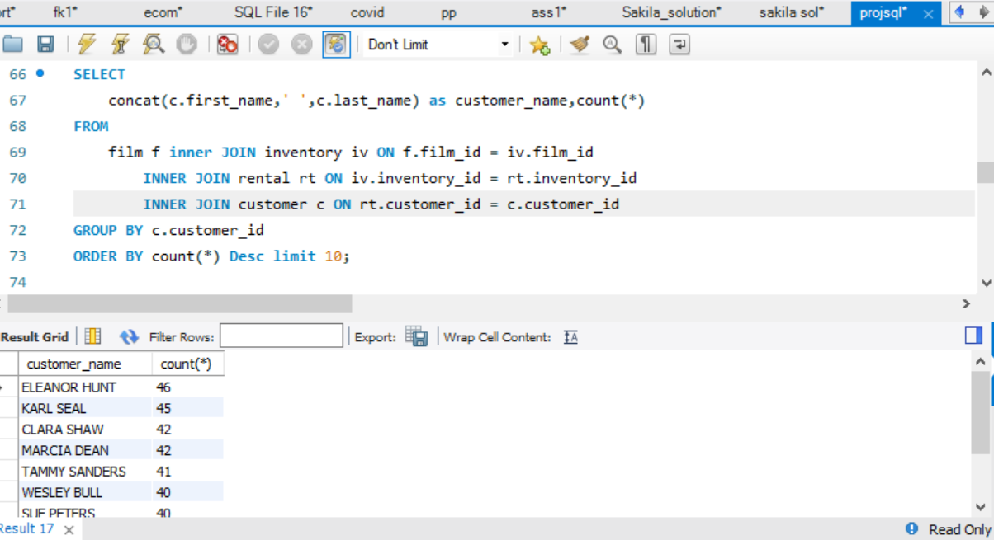
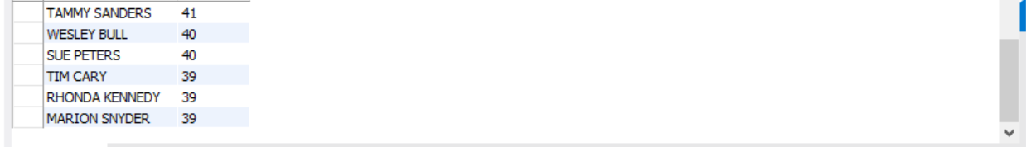
Query4: customers with most rented distinct films

Slide 10
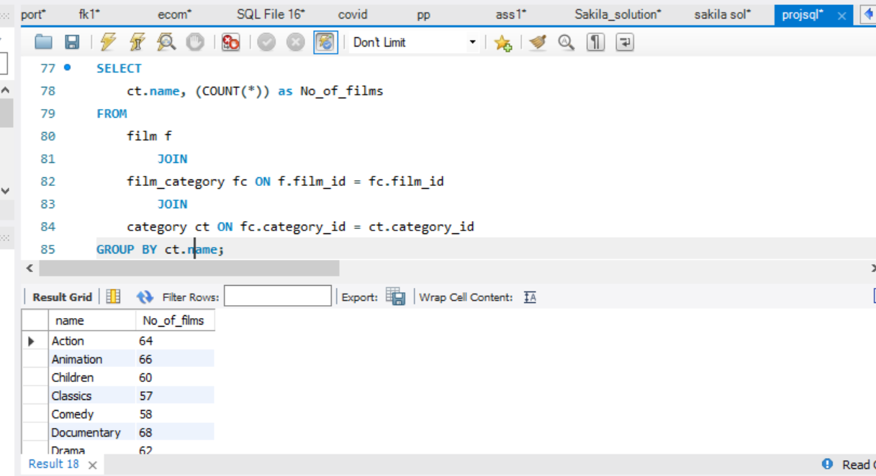
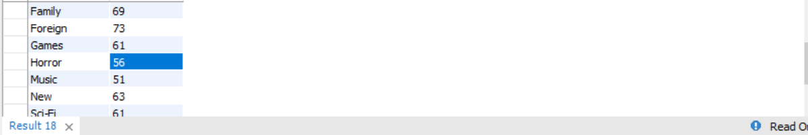
Query5:Films directed based on catagories

Slide 11
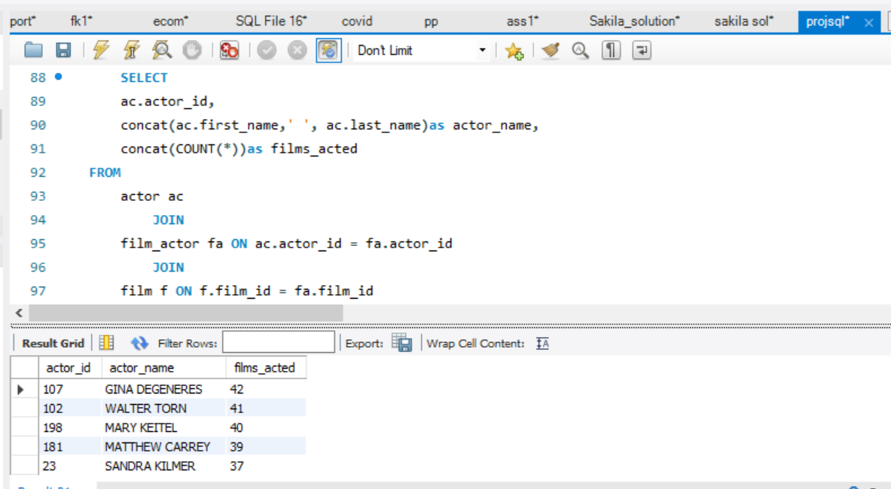
Query6: Actors who acted most number films top 5

Slide 12
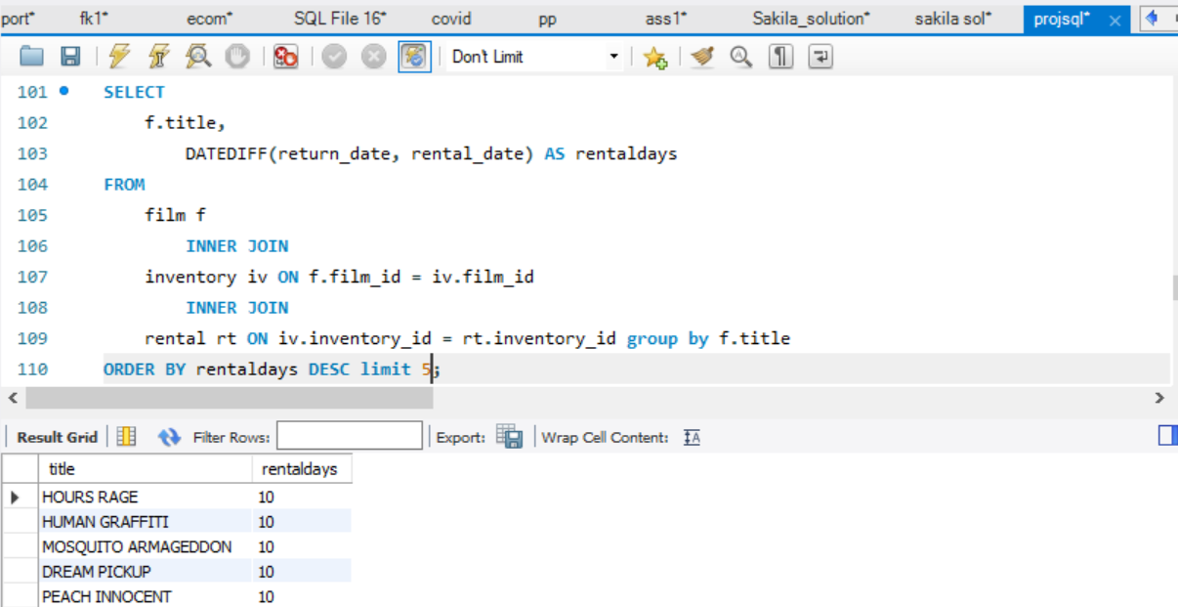
Query7: The film that has been rented for the most days.

Slide 13
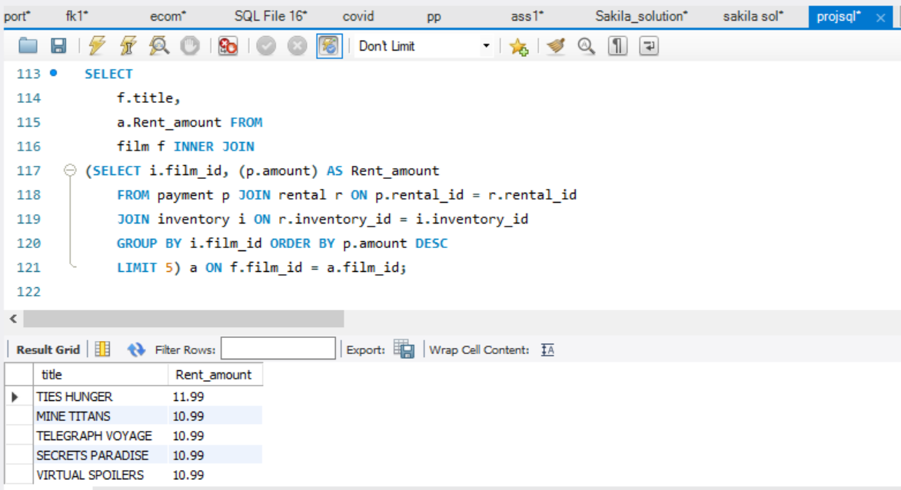
Query8: Top 5 movies with highest rental amount

Slide 14
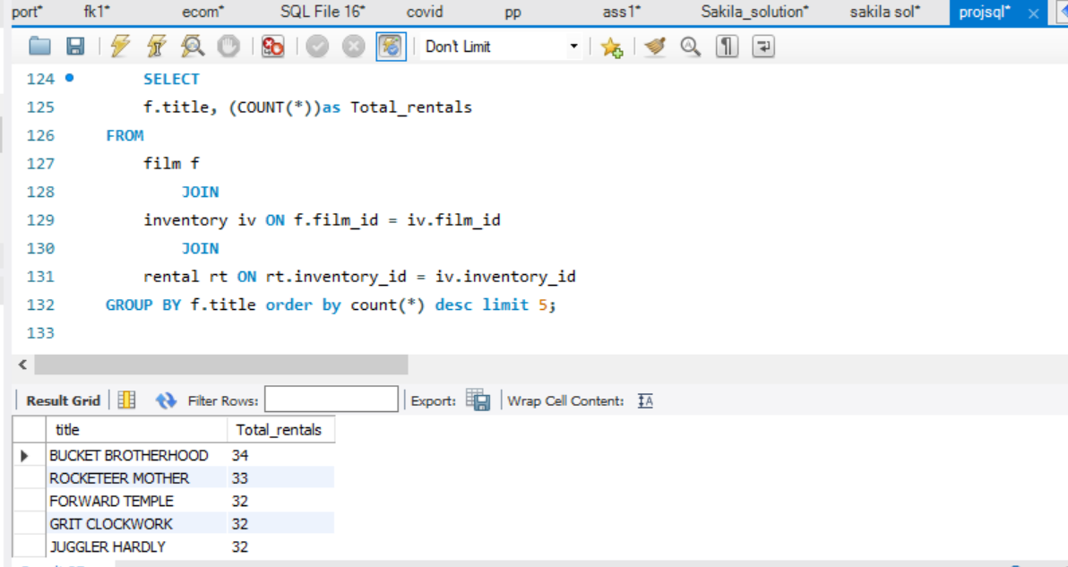
Query9: which films got highest rentals

Slide 15
Business Approach
As we observed they are only two stores are available for the customers and stores are located in Canada and Australia ,to increase the revenue expanding the business is important.
From countries like India, China, USA Japan etc…having more customers comparing with other countries so keeping stores in that countries may help to increase the business.

Slide 16
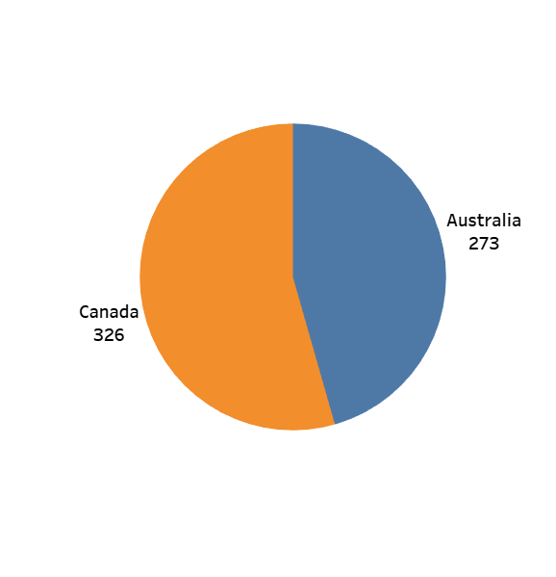
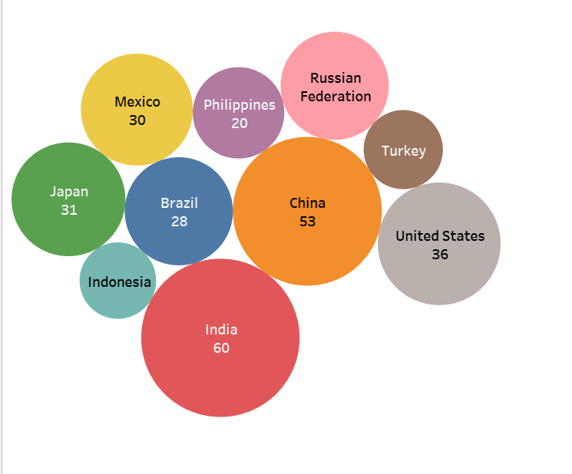
Tableau Insights 1:
Tableau Insights 2
Customers from each country
No.of Customers for each store

Slide 17
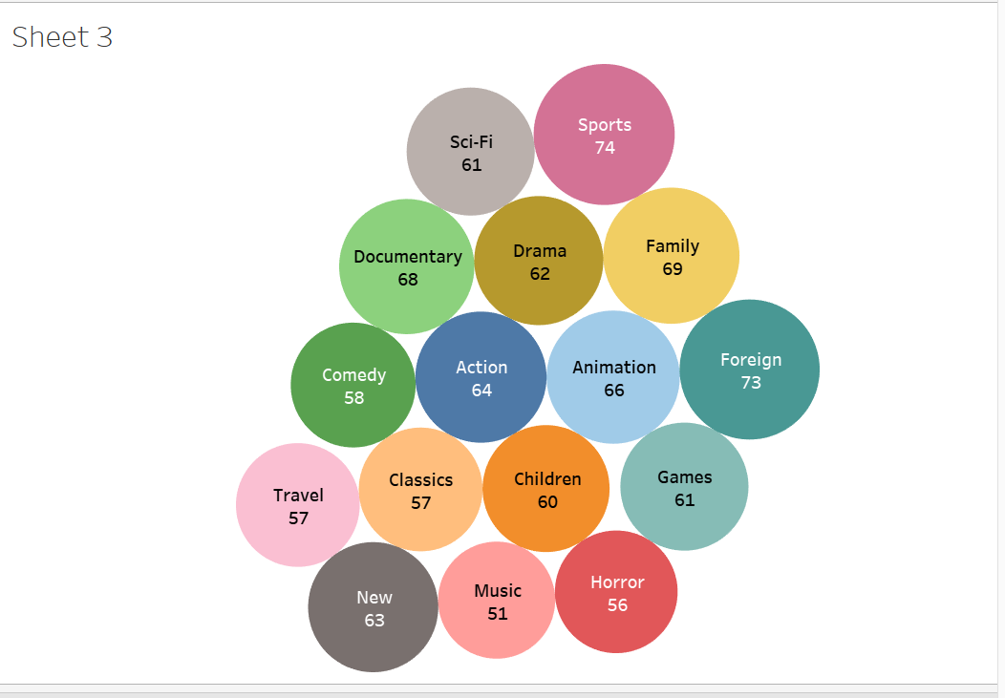
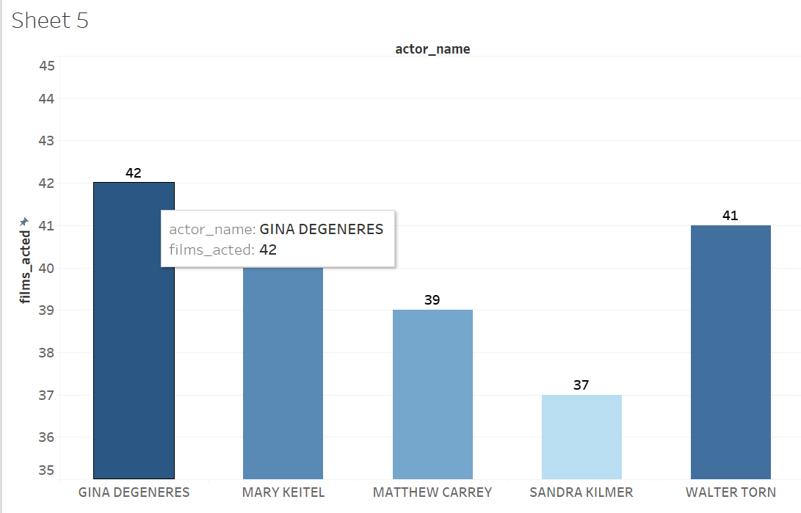
Tableau Insights 3
Tableau Insights 4
Movies based on categories
Actors with most movies top 5

Slide 18
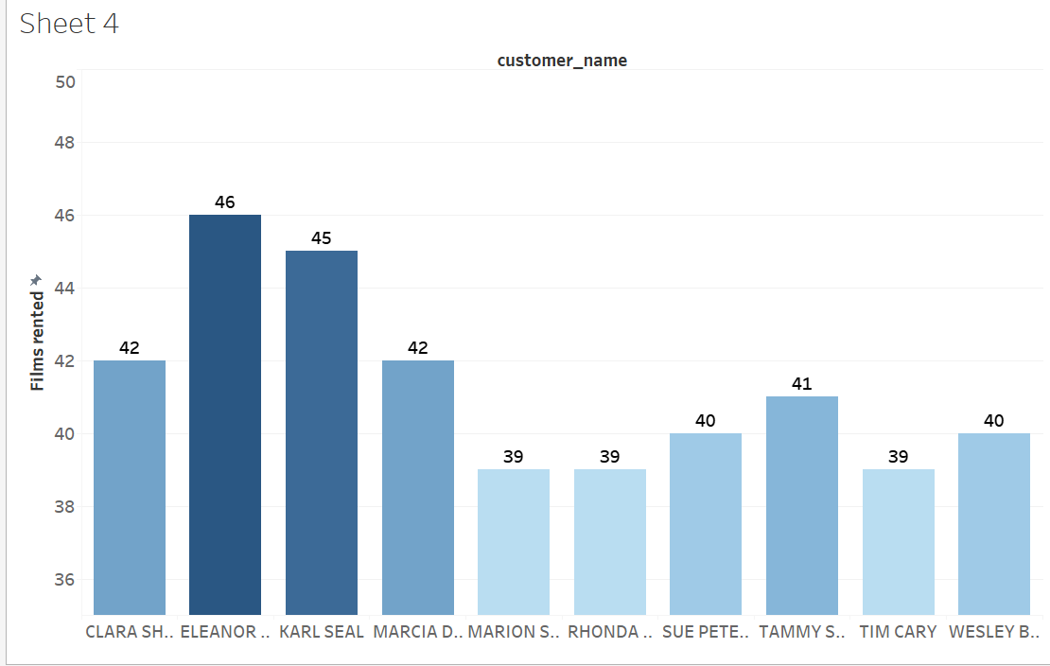
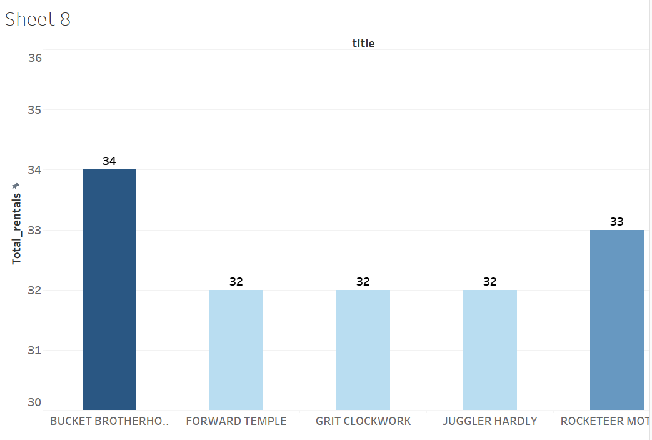
Tableau Insights 5
Tableau Insights 6
Top 10 customers who rented more distinct films
Top 5 movies got highest number of rents

Slide 19
Thank you

